Slide 1
Snow Plow Project
03/01/2018
Zhihui Hong, Ziwei Pi, Haoxuan Shi, Feng Chen

Slide 2
What Problems we are going to solve?
1. City Sidewalk plow Priority
2. Find unplowed streets
3. Find the nearest truck near unplowed streets

Slide 3
The tools we use
1. ARCGIS online
Easy to understand and implement
Make us focus more on problem-solving, GIS and mapping visualization
Create a web application
2. Rstudio & R
Free and open source
Lots of useful geospatial packages online to use, such as “sp” and “gdal”
Easy to process geospatial data

Slide 4
Deliverables
We will focus on methods rather than specific data because snowplow data files are different based on dates.
1. A Web-based GIS application contains multiple layers
Map: https://arcg.is/0WWnuW
WebApplication: https://zhihui.maps.arcgis.com/apps/webappviewer/index.html?id=875f8a1ce85945d9b4ce4a5b34eedaf3
2. A R file to create Unplowed streets shapefiles
3. A R file to filter specific time range of data based on user need and find the latest location of all trucks
4. A R file to transfer address data into geometry coordinates

Slide 5
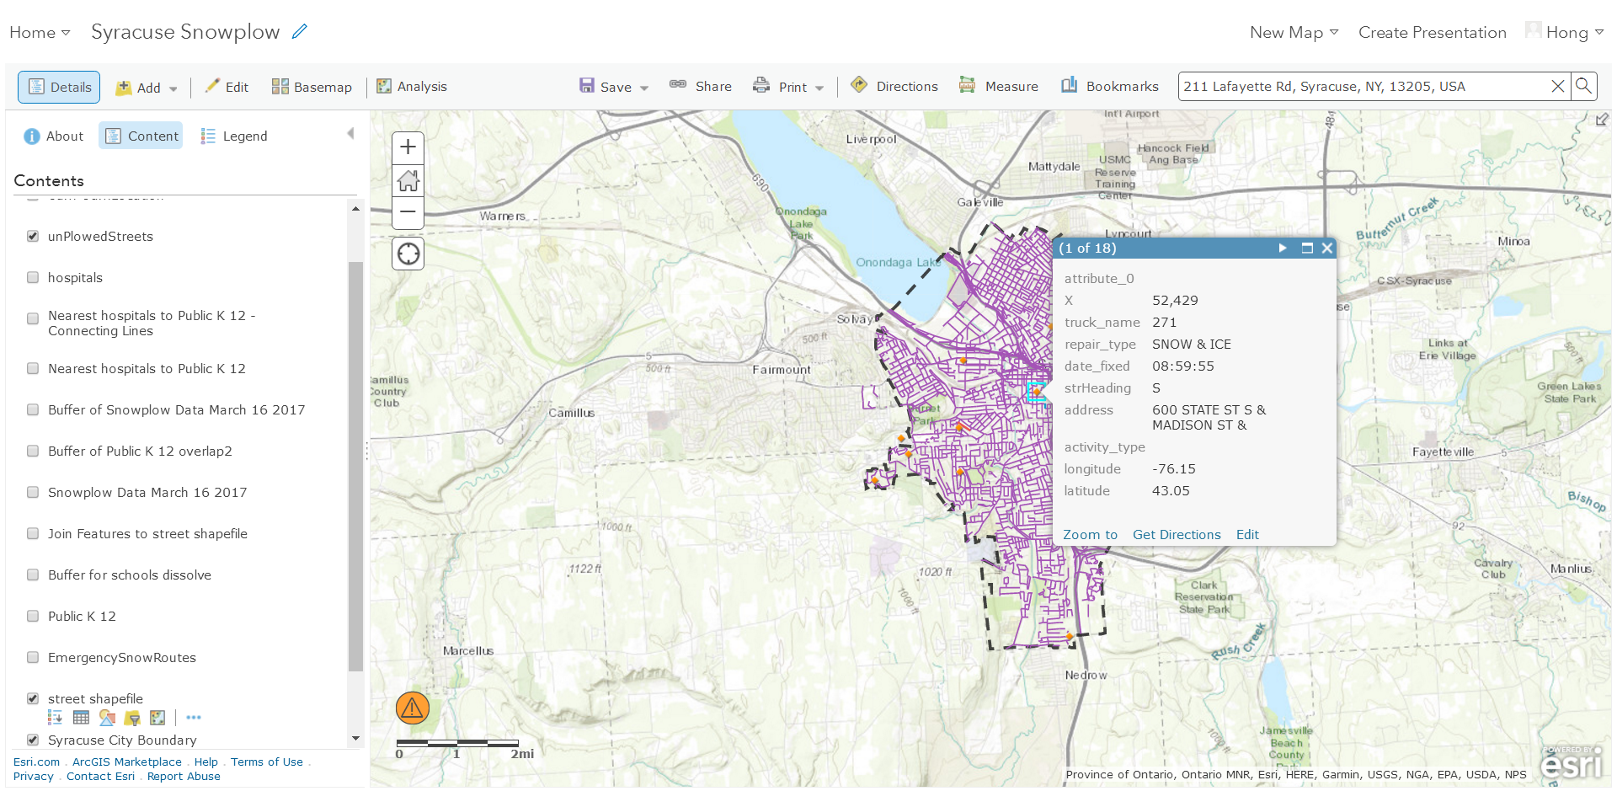
Arcgis Online Overview

Slide 6
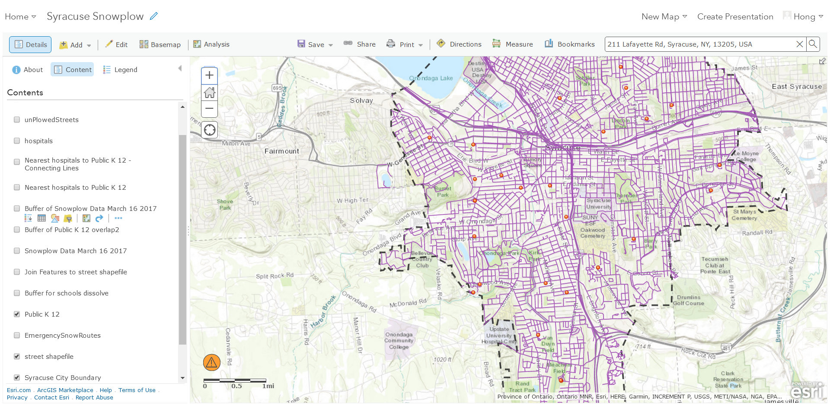
1. City Sidewalk Priority-find schools

Slide 7
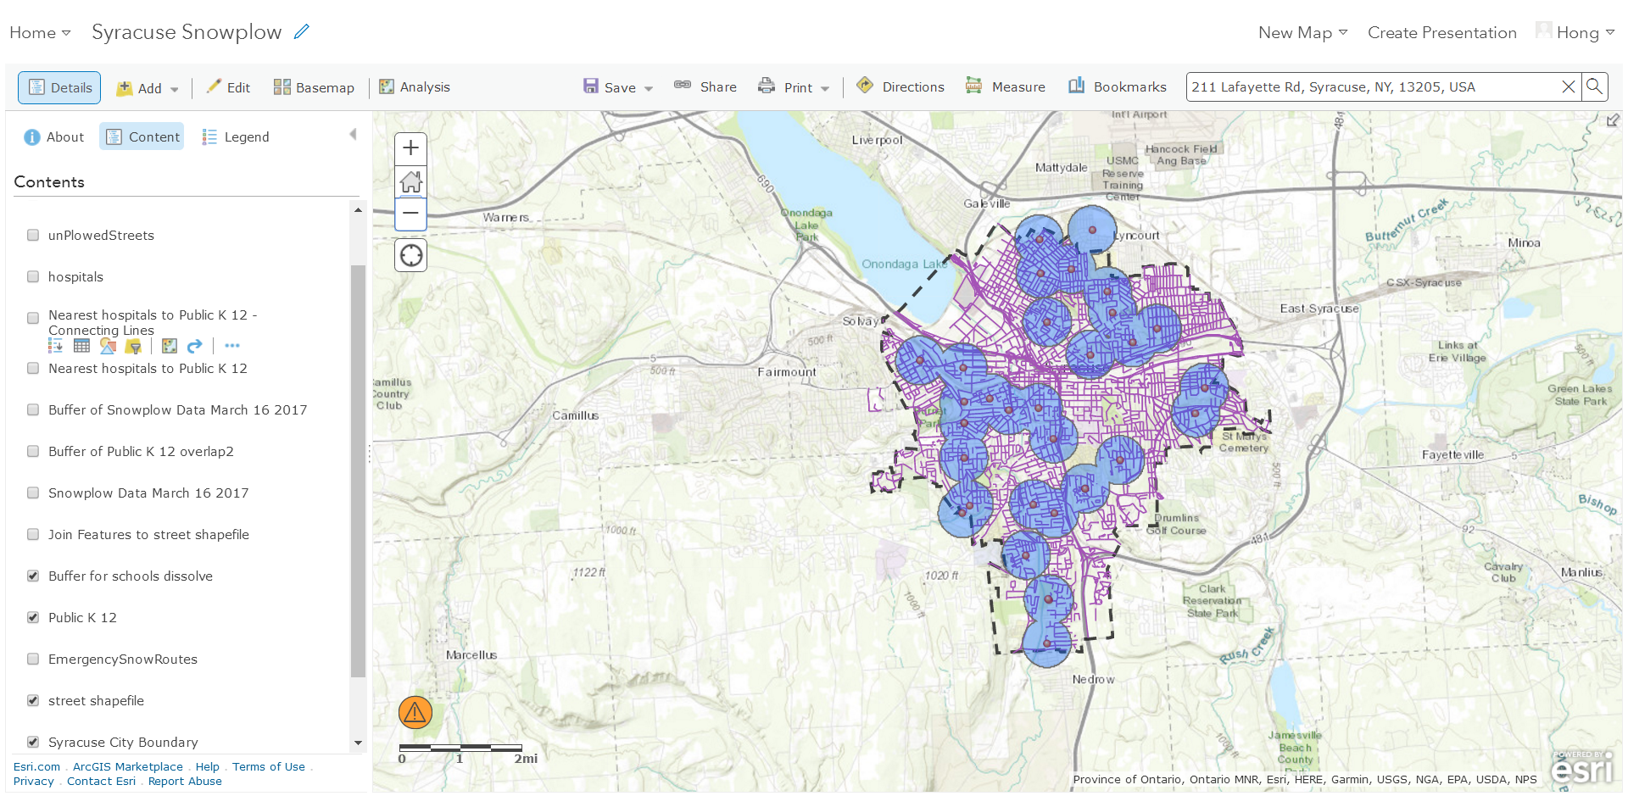
1. City Sidewalk Priority-create buffer area

Slide 8
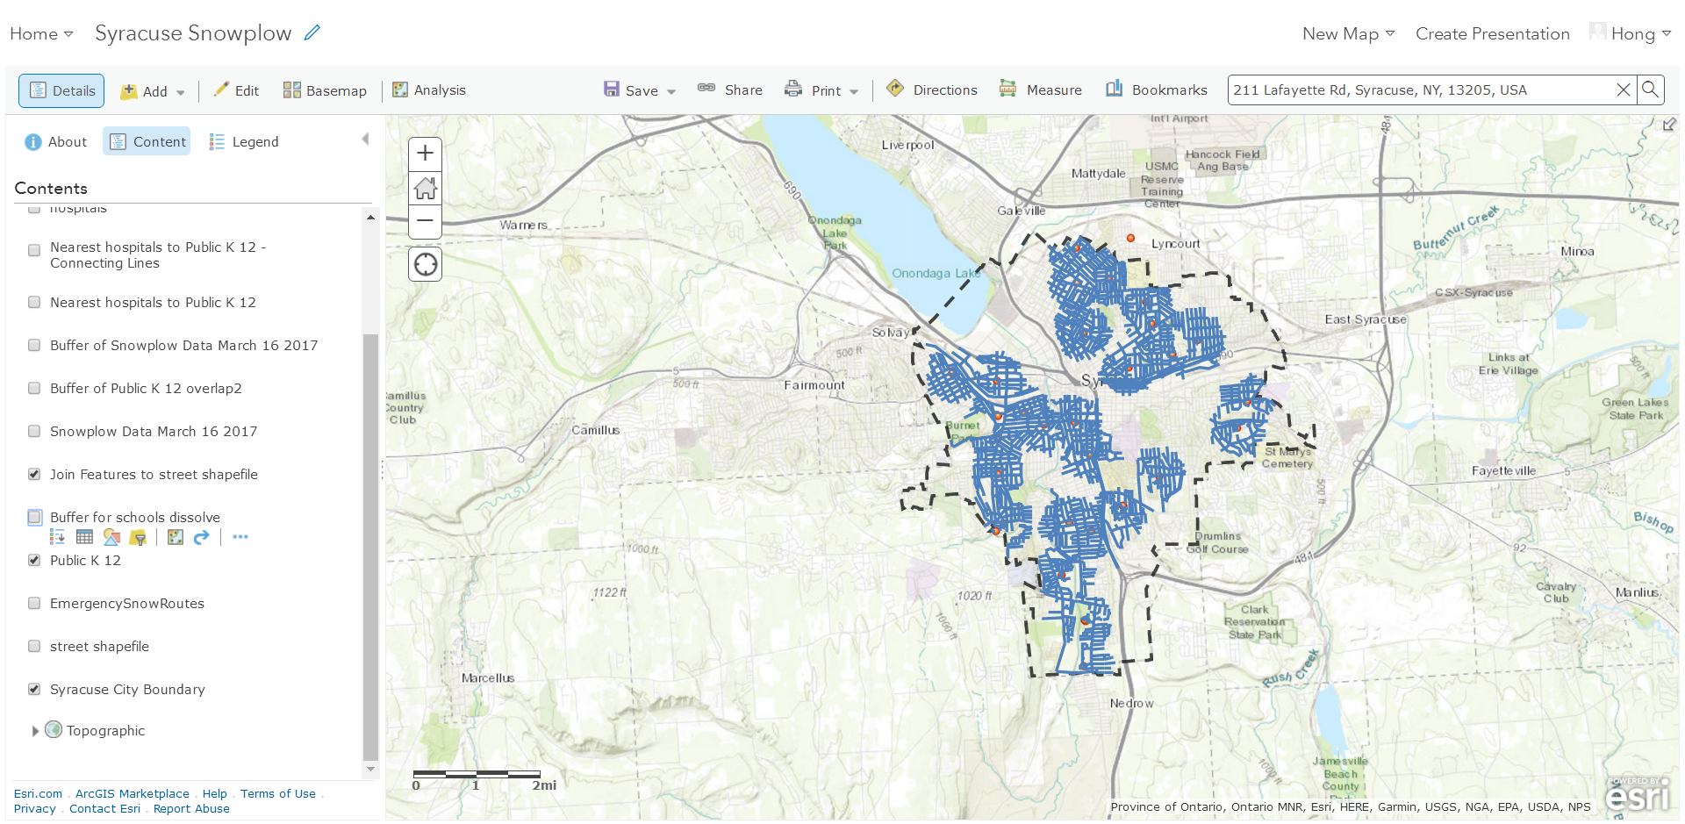
1. City Sidewalk Priority-streets intersection

Slide 9
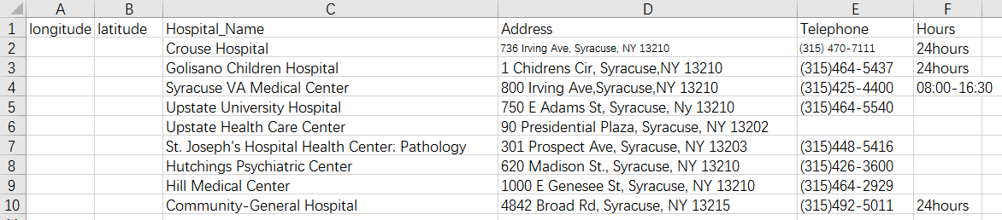
What if we want to add another category of data?
For example, we want to plow sidewalks around not only schools but also hospitals.

Slide 10
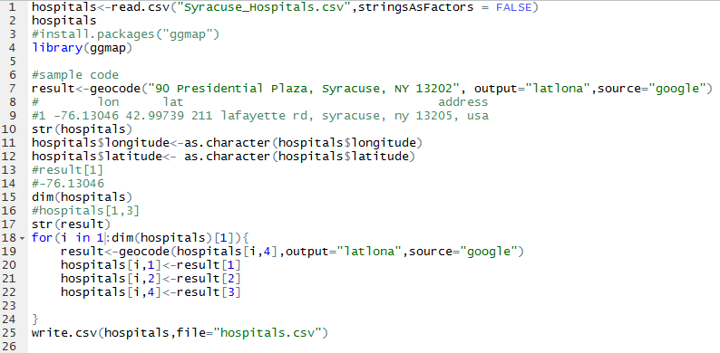
What if we want to add another category of data?

Slide 11
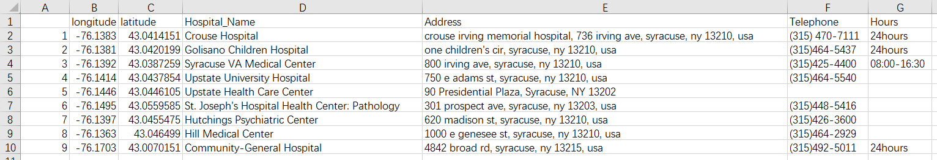
What if we want to add another category of data?

Slide 12
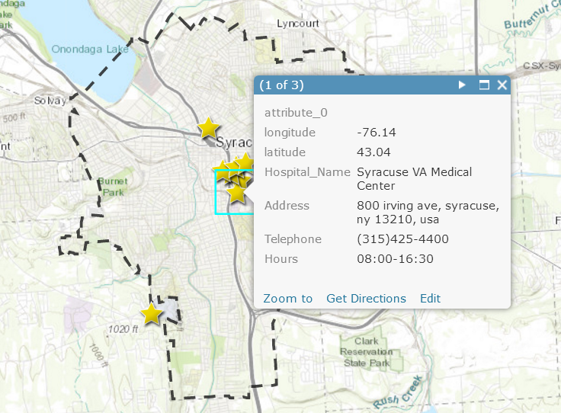
What if we want to add another category of data?

Slide 13
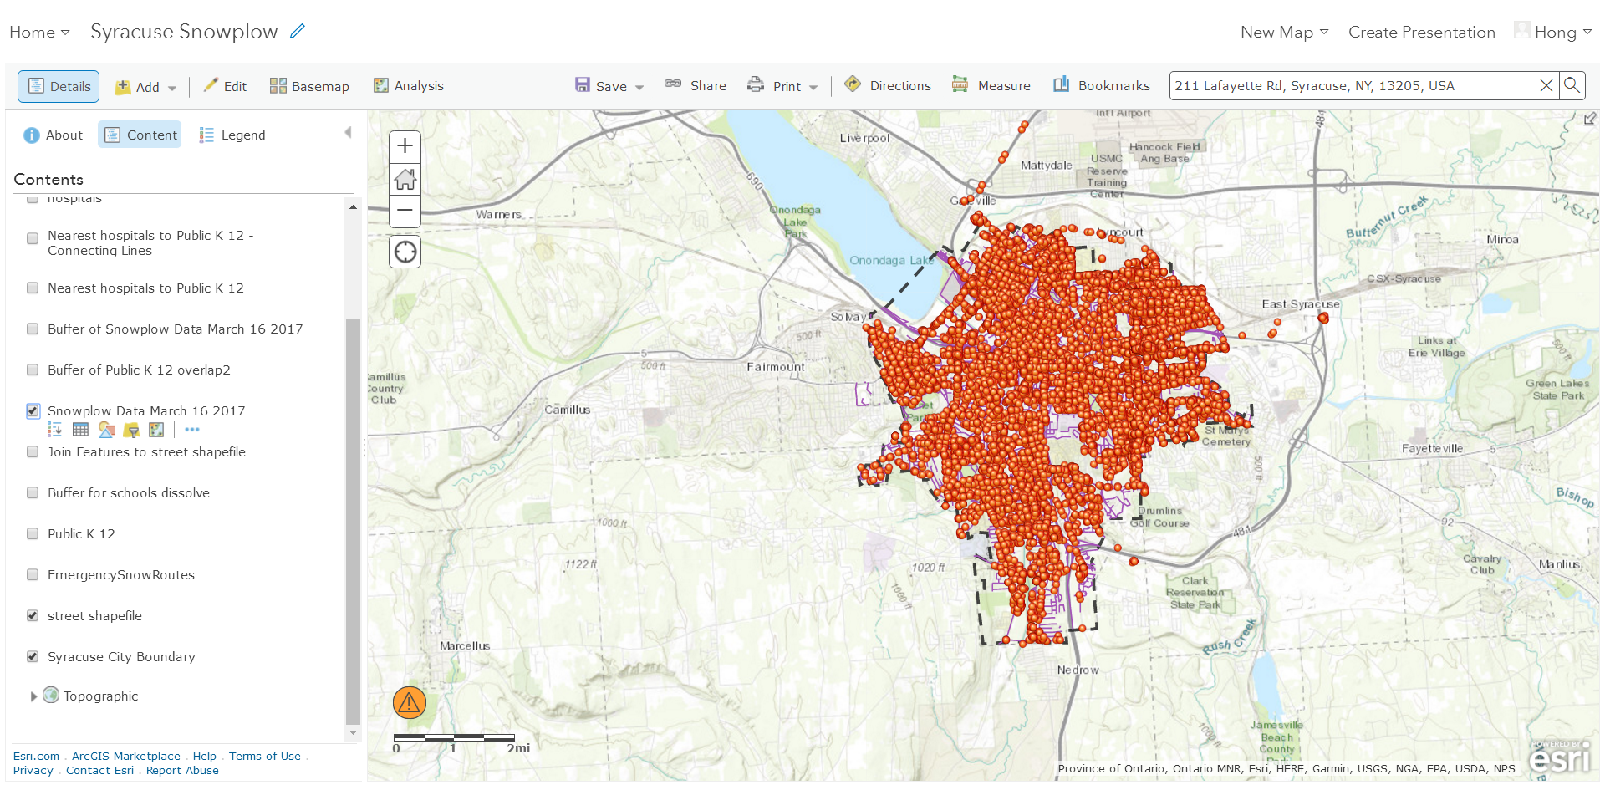
2. Find unplowed streets

Slide 14
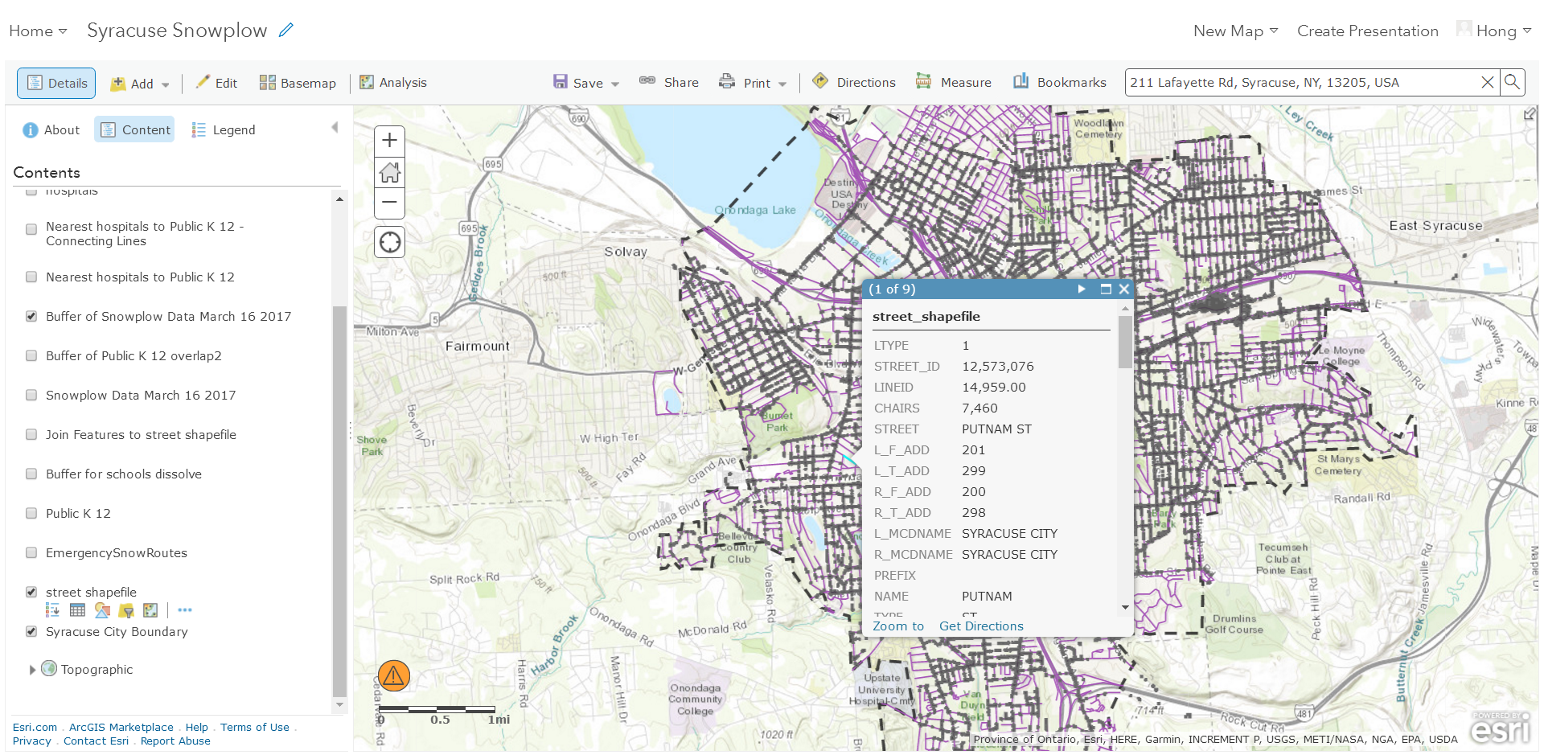
2. Find Unplowed streets

Slide 15
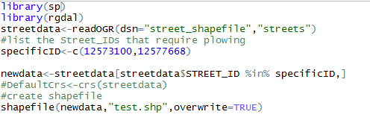
2. Find unplowed streets

Slide 16
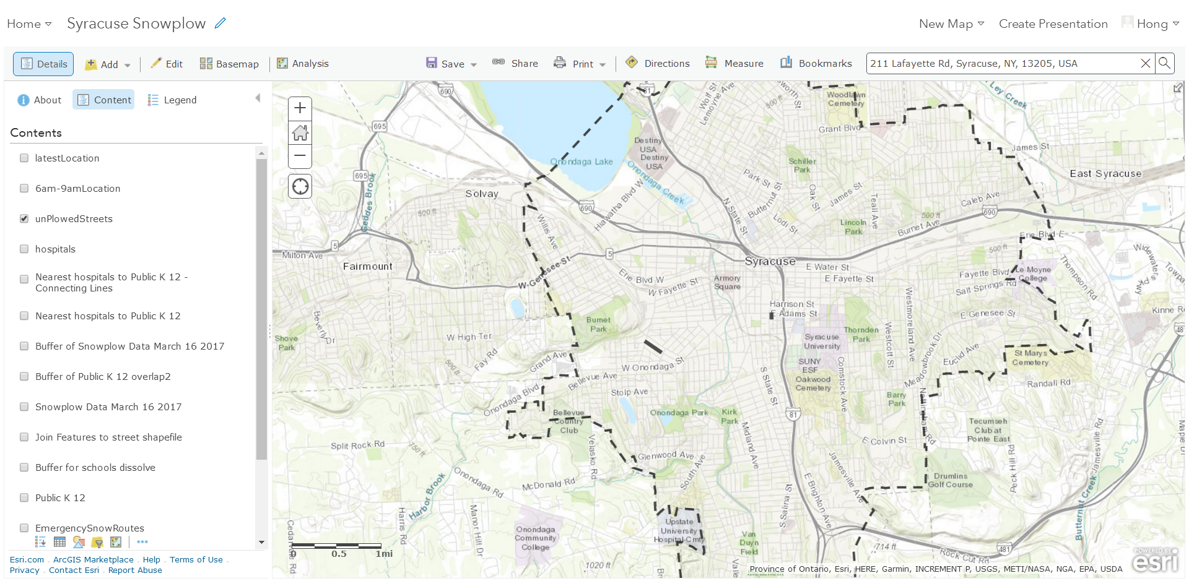
2. Find unplowed streets

Slide 17
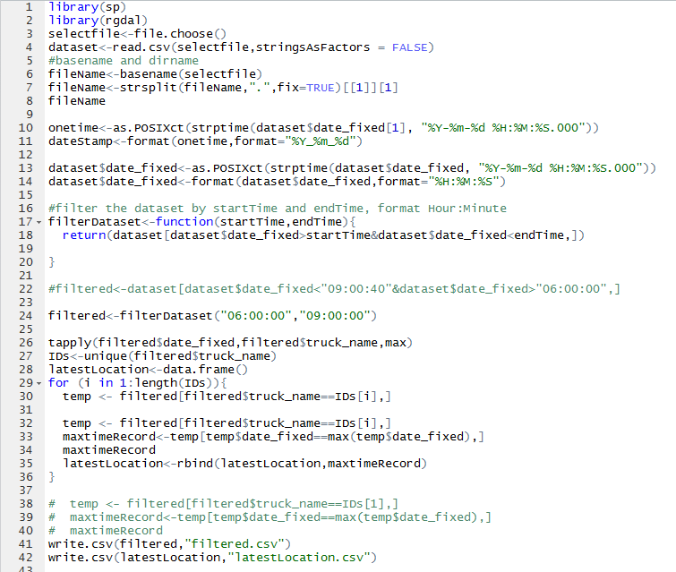
3. Find nearest trucks near unplowed streets
We may want to specify time range
Filter dataset
Find latest location of trucks
Create spatial-points file in csv format

Slide 18
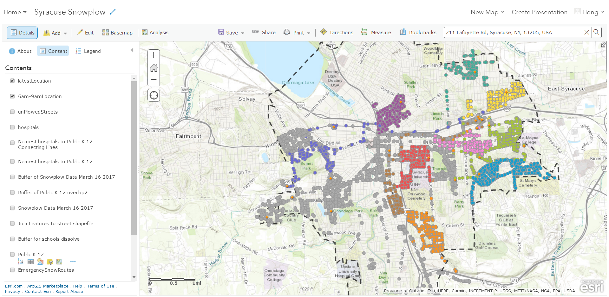
3. Find nearest trucks near unplowed streets

Slide 19
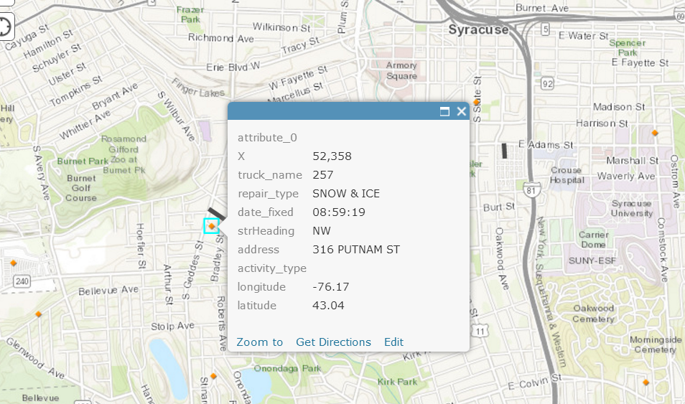
3. Find nearest trucks near unplowed streets

Slide 20
Thank you!
Question?

